Slide 2
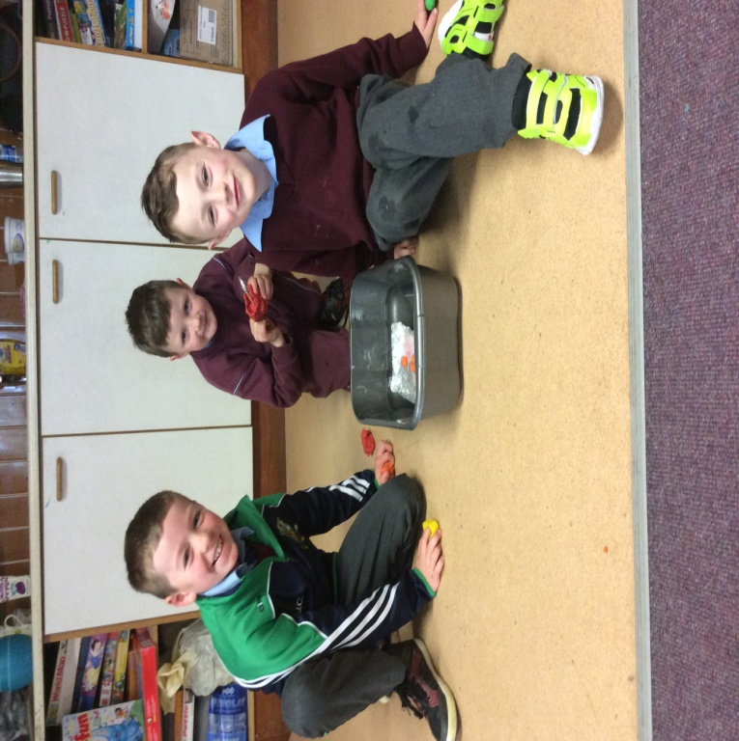
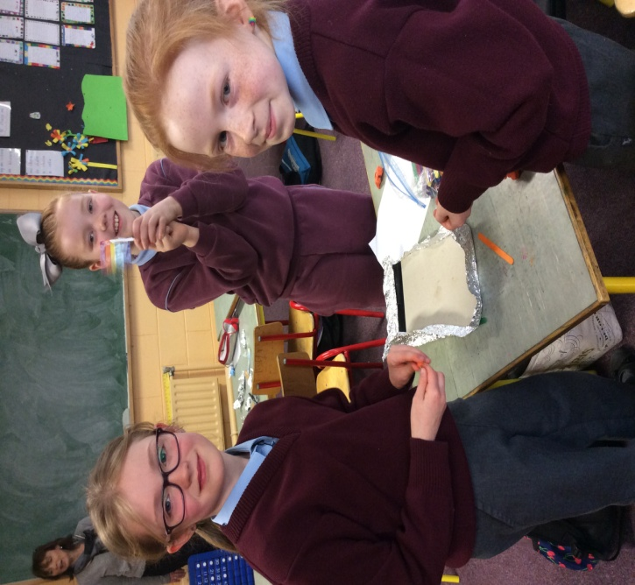
Coachford National School
Discover Primary Science and Maths
Log of Evidence 2016/2017

Slide 3
Calendar of Events Science at a glance through the year
Term 1 | Term 2 | Term 3
Classroom science investigations in all strands take place throughout the year
Lismore Science Workshop | Vex robotics IQ Challenge | Investigating biodiversity with Heritage Specialist Jessica Mason
 | RDS Young Scientists Exhibition
School Science Week | Visit of Simon and Alison Harrison (UCC) | Visit to Lifetime Lab (after submission of log)
 | Developing our school garden Tír Draiochta

Slide 4
Science Investigations Science Visitor
Step 1

Slide 5
Science Investigations
Strand | Living Things | Energy and Forces | Materials | Environmental Awareness and Care
Investigation | Seed bombs (Infants) Tír Draíochta our new school garden (Gach Rang ) Investigating mould on bread (Rang 1+2) | Designing and making boats (Rang 1+2) | Is it waterproof? (Infants) | Investigating bugs! (all classes)

Slide 6
Making seed bombs (Infants)

Slide 7
The children mixed soil, water and seeds together to make a paste which was then wrapped in tin foil. These ‘seeds bombs’ were then left in a warm area for a few weeks to allow the seeds to germinate. The tin foil was then discarded and the balls of soil and seeds were scattered onto our new school garden to grow.

Slide 8
Tír Draíochta – our new school garden. Infants, 1st, 2nd, 3rd and 4th classes planted flowers in old tyres to add colour to our new flower beds. A past pupil Joanne helped with this work. These flowers have been watered and cared for by the children since setting.

Slide 9
5th and 6th classes planted flowers in old jeans to add to our new garden - Tír Draíochta

Slide 11
Investigating the growth of mould on bread (Rang 1+2)

Slide 12
We put 6 slices of plain, white bread in different locations in our classroom . The conditions were changed for each slice. The conditions we changed were: light; dark; dry; damp and wet. We left them for a week in each place. The most mould grew in the dark and wet location. The least mould grew in the bright and dry place. We learned that bright and dry conditions are best for storing bread.

Slide 13
Designing and Making Boats (Rang 1+2)

Slide 15
Waterproof experiments - Infants
Experiment: Exploring what substances are waterproof or not
Materials tested: rubber gloves, plastic, newspaper, tin foil and cloth
We firstly predicted what materials would be waterproof or not, and then we investigated...
Results: The children discovered that the rubber gloves, plastic and tin foil were waterproof, while the newspaper and cloth soaked up the water.

Slide 16
Investigating Bugs with Drs. Simon and Alison Harrison
A wide variety of bugs were collected from our immediate environment. The children

Slide 17
We used a key to identify what species we could see.
Muireann waits her turn!
Exciting discoveries!

Slide 19
Rachel and Sophie are not so sure!
Alison explains to Dallum, Kacey and Áine

Slide 20
Simon brought his pet snake, Bertha!

Slide 21
Technology 1.Programming with VEX Robotics 2.Using powerpoint
Step 2

Slide 22
VEX Robotics at Coachford NS We were involved in the Vex Robotics Programme again this year. Through the programme we experienced engineering, building and programming.

Slide 23
Programming
We used Robot C and Modkit software to devise the programme for running the Robot. This software allowed us to use simple Co-ordinate language, rotations and degrees. We also made use of time for the commands we devised. We also used the Robot Virtual Worlds to practice programming without and arena.

Slide 24
We participated in the Vex robotics competition in Cork Institute of Technology in January 2017. We did very well and improved on some of our scores from last year.

