Slide 2
6th class pupils presenting their findings using Powerpoint

Slide 3
ROBOTICS IN HEALTHCARE
By Niamh, Clara, Orna, Rachel, Amy, Jack and Jennifer

Slide 4
5 amazing ways that robots are used in healthcare
To train doctors
To diagnose disease
To perform surgeries
To rehabilitate patients
To restore lost limbs and other body parts

Slide 5
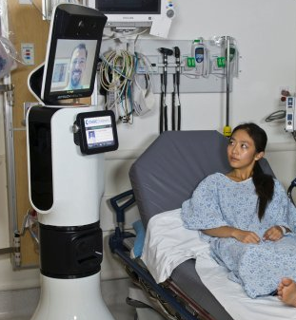
Consulting with patients
Doctors can use Skype and other different methods to consult with patients

Slide 6
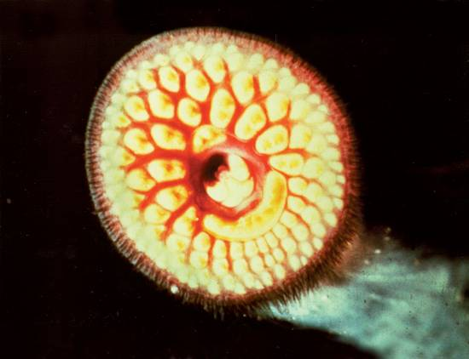
to diagnose disease
Robots are used to diagnose diseases that might be too difficult to otherwise detect

Slide 7
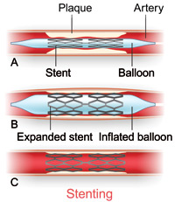
Stents in the heart
A person could get a stint in their heart after a heart attack or heart issues.

Slide 8
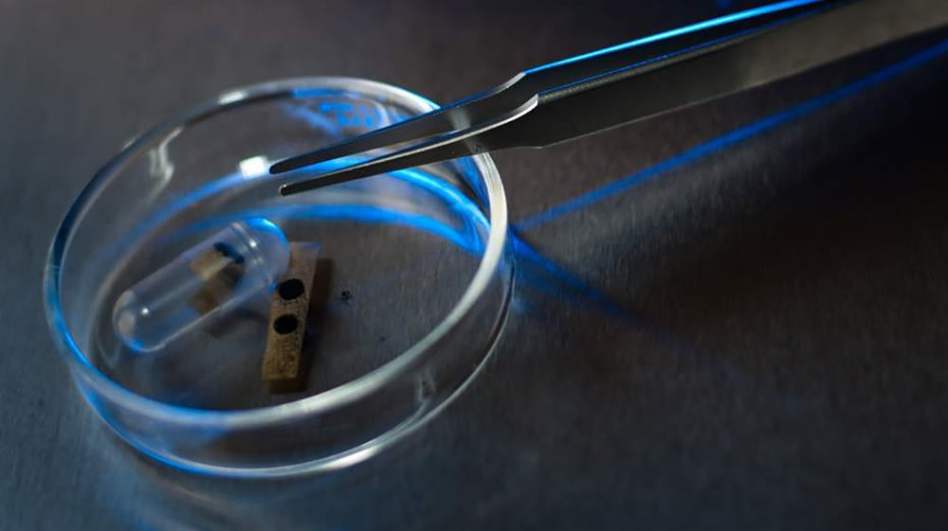
Robots are being used all over the world in healthcare to diagnose different diseases

Slide 9
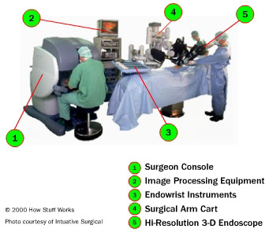
Robots are used to perform surgeries that are too difficult for human hands

Slide 10
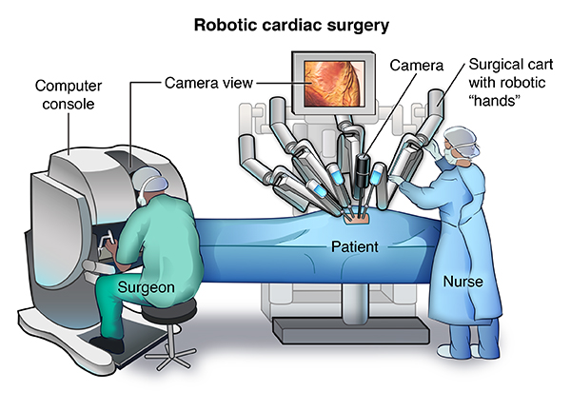
Robot performing surgeries
When a person is very ill and needs an operation very fast robots can be used to do the surgeries

Slide 11
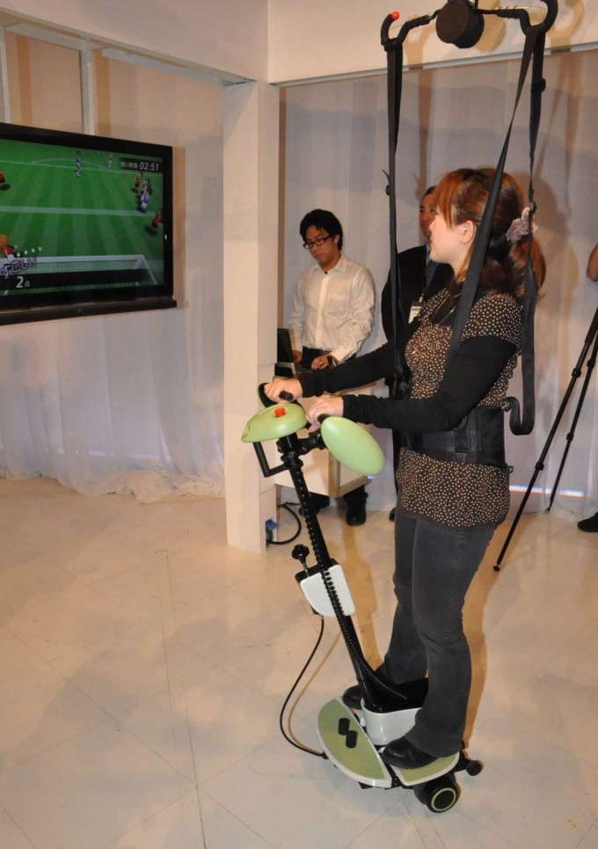
TO REHABILITATE PATIENTS
Robots are used to rehabilitate patients after accident or injury

Slide 12
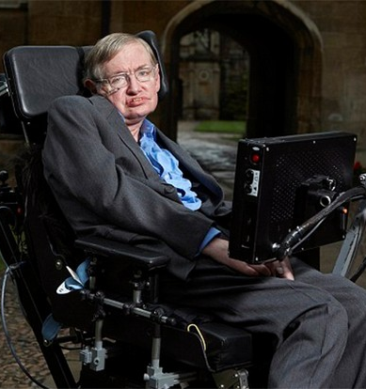
Independent living
Robots can give more independence to people who suffer from serious diseases

Slide 13
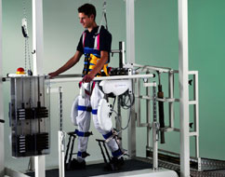
To help people recover faster
Robots are now being used to rehabilitate patients and get them back to full health

Slide 14
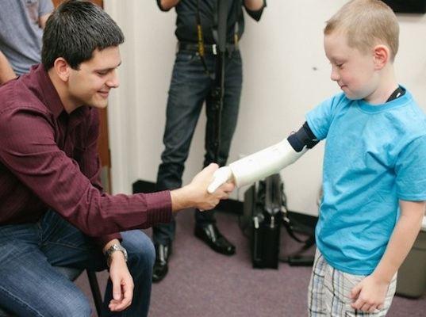
TO RESTORE LOST LIMBS
Robots can give more independence to people who have lost limbs

Slide 15
Our presentation
This is our project on robotics in healthcare. We really enjoyed doing it and have learned so much.

Slide 16
Thank you so much for watching!!! We hope you enjoyed

Slide 17
Engineering 1. what is the best material for teabags? 2. Designing and Making bird feeders for Tír Draíochta 3. Making Green houses
Step 3

Slide 18
Designing and Making Teabags (Rang 3+4)
We examined a teabag to see how it was made. Then we looked at a variety of different materials and used them to make tea bags. The best material was a strong kitchen paper. It didn’t make very nice tea though!

Slide 19
Designing and Making Bird Feeders (Rang 3+4)
Garret: These were some bird houses we made at home. I needed to think about painting , hanging. We also gave some thought to the durability of the feeder.
Jimmy: I measured the bottom of the feeder and I cut a piece of wood as a stand. I screwed the feeder on to the platform. I put two holes in the top to put some bungee string in. This is elastic string which is stronger than normal string. I used oil based paints to decorate the feeder. There is a hole for the birds which is not too big. I didn’t want any big birds in my feeder.
Tiegan: I got an old coca cola bottle which I cut in half. I put the top over the bottom. In used elastic thread. I cut a little bit of a flap so that all birds could use it but they couldn’t go in. I decorated it with flowers so that it would blend in with the trees.

Slide 20
Designing and Making Mini Greenhouse
We cut off the top of a 2 litre drinks bottle and we placed the top half inside the bottom half. We removed the cap. We filled the top half with soil and earth. We planted wildflower seeds in the green house. Then we brought them home. At this stage some of them have grown flowers.

Slide 21
Maths 1. Measuring How Long does it take the parachute to fall? 2. Biodiversity Survey Results (Green School Committee) 3.Investigation of Core Muscle Strength: Keeping a tally; using pie charts, block graphs and trend graphs 4.Feedback from RDS Primary Science fair Judge
Step 4

Slide 22
Measuring How Long does it take the parachute to fall? (Rang 1+2)

Slide 23
Biodiversity Survey Results (Green School Committee)

Slide 24
Investigation Core Muscle Strength (Rang 5+6)

Slide 25
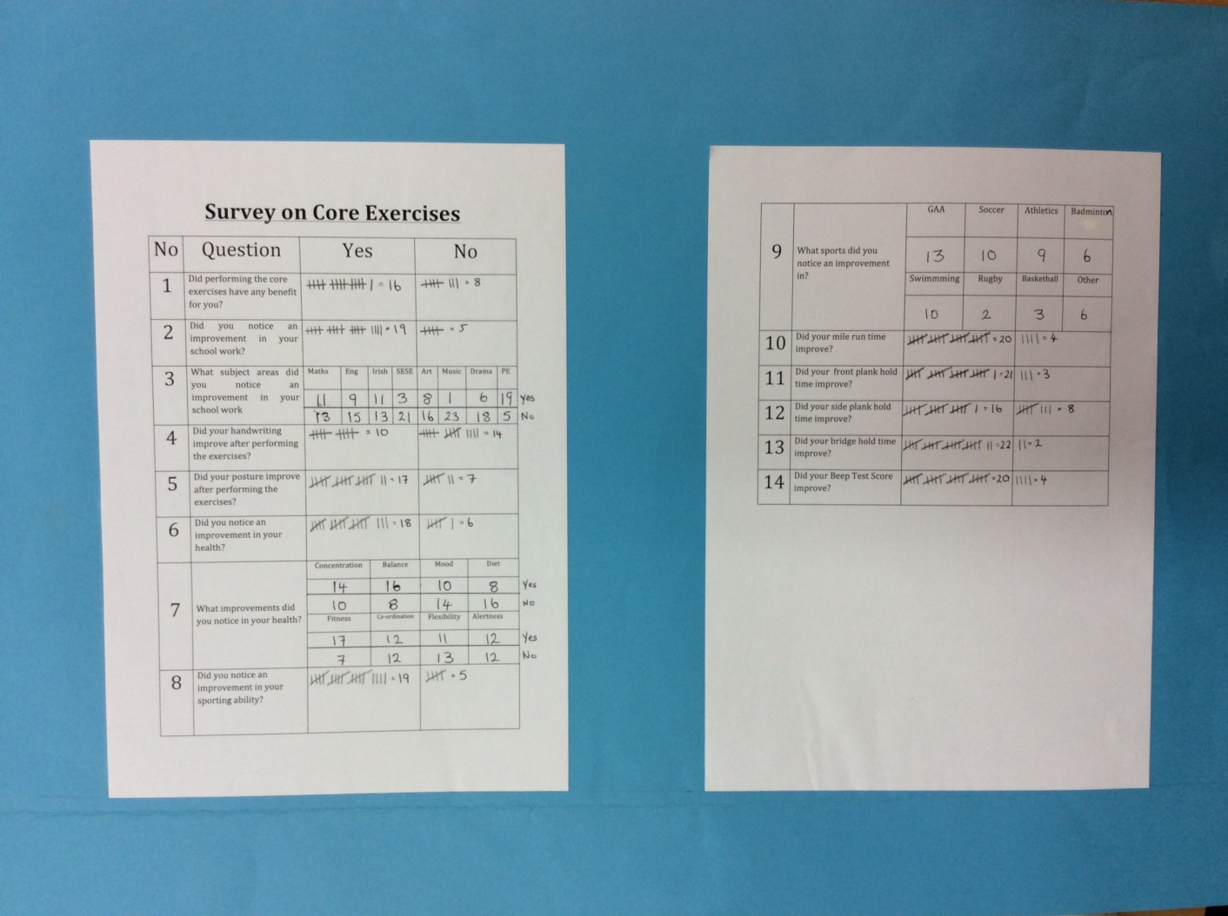
Keeping a Tally

Slide 26
Using Pie Charts

Slide 27
Showing Data on a Blockgraph

Slide 28
Using Trend Graphs

Slide 29
Feedback
The judge, Michael Browne particularly enjoyed our use of Mathematical displays. These enhanced our project and made the interpretation of the results much clearer.

Slide 30
Show and Tell 1. Coachford NS Science Expo 2. Limerick Education Centre Junior Scientist Science Fair
Step 5

Slide 31
Science Week Expo November 2016

Slide 32
Junior and Senior Infants explain their work

Slide 33
5th and 6th class show their work on core muscle strength

Slide 35
Limerick Education Centre Junior Scientist Science Fair

